Slide 1

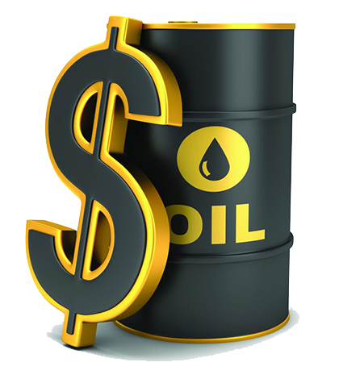

HR ATTRITION ANALYSIS FOR MAYROYCE OIL &GAS COMPANY BY OBIKEZIE JACINTA .E. ON 18/09/2024
This Photo by Unknown Author is licensed under CC BY-NC
This Photo by Unknown Author is licensed under CC BY-NC
This Photo by Unknown Author is licensed under CC BY

Slide 2
INTRODUCTION
MAYROYCE HR Attrition Analysis is a comprehensive examination of the factors influencing employee attrition within Mayroyce, a global oil and gas company. Attrition is the voluntary and involuntary departure of employees from an organization, which can have a noticeable effect on the company’s performance, productivity and overall workforce stability.
This analysis touches the various aspect of HR attrition within the company, aiming to provide valuable insight into the causes, patterns and trends associated with employee turnover by examining factors such as; job satisfaction, year of service, performance management, age group analysis, etc.
This analysis seeks to shed light on why employees choose to leave Mayroyce and how the company can address these issues effectively.

Slide 3
OBJECTIVES
The goal of the Mayroyce HR Attrition Analysis is to provide actionable insights that enable Mayroyce ‘s human resources department to make informed decisions and implement effective retention strategies by identifying the root causes of attrition and implementing targeted interventions.
Objectives:
Calculate the necessary KPI
Using an interactive visual, explore the top reasons why employees leave the organization.

Slide 4
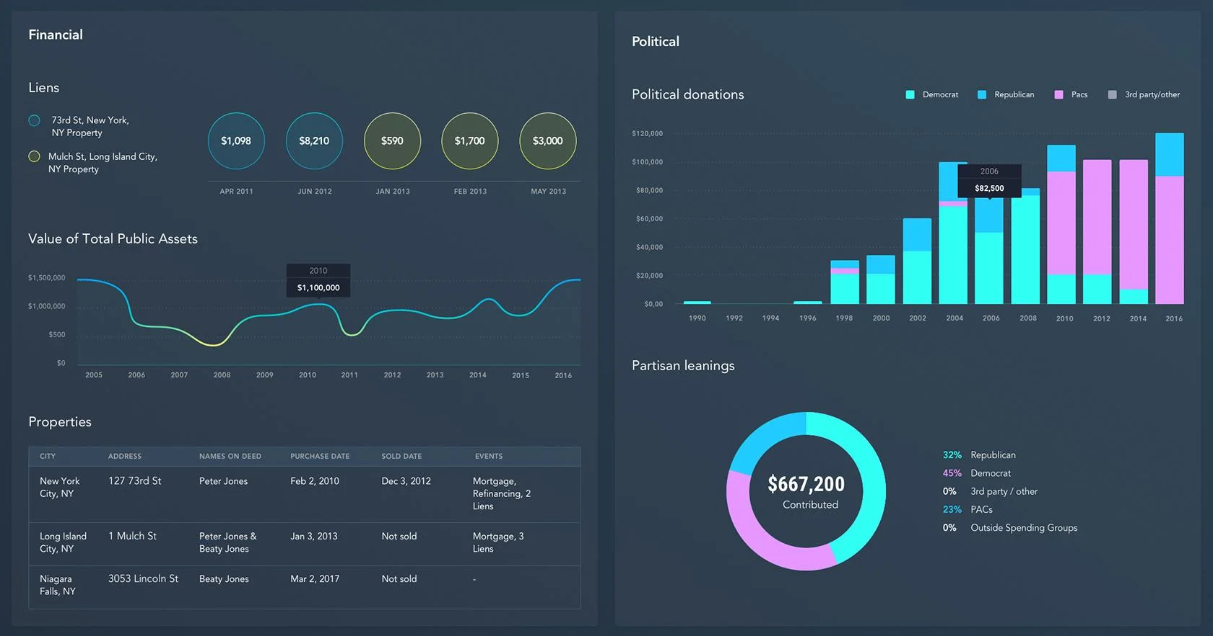
KEY FACTS
Demographics
Average age =>33.9;58% male and 42% female.
2 Attrition
30% rate, highest in Finance in HR.
Performance
70% below expectations, average performance rating => 6.8
Satisfaction
Average satisfaction is 3.8, highest in Engineering, lowest in HR.
This Photo by Unknown Author is licensed under CC BY-SA-NC

Slide 5
KEY INSIGHTS
WORKFORCE ANALYSIS
*There is gender imbalance in Engineering department.
*The sales team consist of mainly youths.
PERFORMANCE STUDY
Positive relationship between performance and satisfaction.
ATTRITION ANALYSIS
Attrition is relatively high among 31-35years,entry levels, females and in departments like Finance and HR.

Slide 6

CONCLUSIONS
PRODUCTIVITY EFFECTS
High attrition affects cost of training, knowledge maturity, operational
continuity and competitive strength of the company.
RETENTION IMPACT
Long-tenured employees perform better.
PERFORMANCE ISSUES
Below –average performance requires immediate intervention.
This Photo by Unknown Author is licensed under CC BY-SA

Slide 7

RECOMMENDATIONS
Attrition analysis
Conduct exit interviews or surveys to understand the employees’ dissatisfaction
and address any underlying issues.
Employee Engagement
*Focus on improving job satisfaction for better employee retention.
*Provide opportunities for career development and growth to increase employee
engagement and loyalty.
Performance Management
*Review performance status across departments to identify any correlation with
Attrition rates.
*Offer additional support or training to underperforming employees to improve job
satisfaction and retention.
Diversity and Inclusion: Ensure equal opportunities for employees of all genders.
Continuous Monitoring: Regularly review and update the attrition dashboard to track
Progress and adjust strategies as needed to maintain healthy retention rate.
This Photo by Unknown Author is licensed under CC BY-SA

Slide 8




NEXT STEPS
Improve Compensation and Benefit packages: Conduct salary benchmarking to ensure competitive pay.
Enhance Career Development Programs: Create clear paths for promotion and skill development.
Leadership Training : Train managers on empathetic leadership and creating positive work environment.
Exit interviews and Feedback loops: Gather insights from departing employees and act on the feedback.

